Slide 1

Introduction to Python for Data Science
Session 2 - Working with data
Created by (Benjamin Frost) for City Data Science Society 2021

Slide 2
Introduction
Structure of today
Structure of the course
Week 1: Coding in Python
Week 2: Working with Data
Week 3: Machine Learning Algorithms
Week 4: Advanced Libraries & Class Project
Notes:
I’ve spent the last year completing qualifications and working with academics at City on research projects.

Slide 3
Last week’s work

Slide 4

What is Pandas?
Pandas is a library in Python used to store and format data.
Can be used to clean and manipulate data quickly.
Works well with other Python libraries such as MatplotLib.

Slide 5
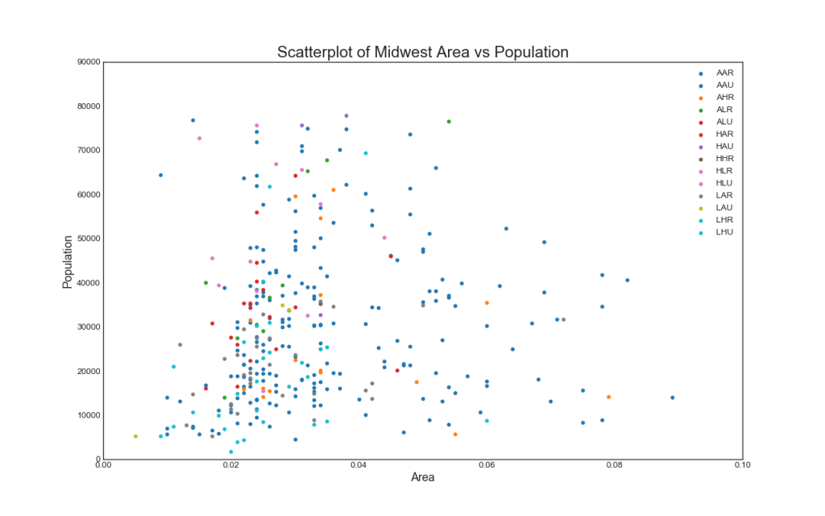
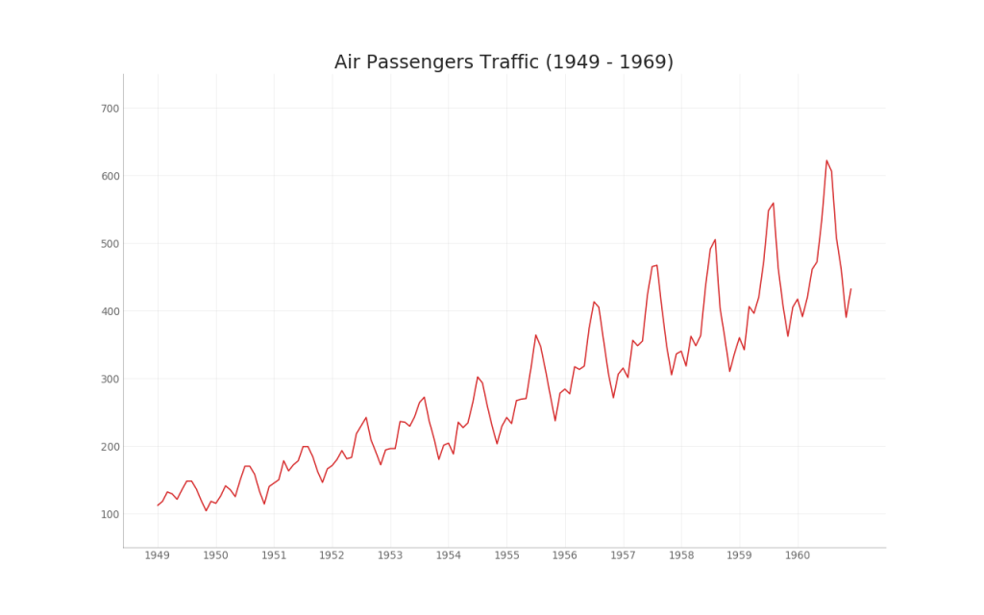
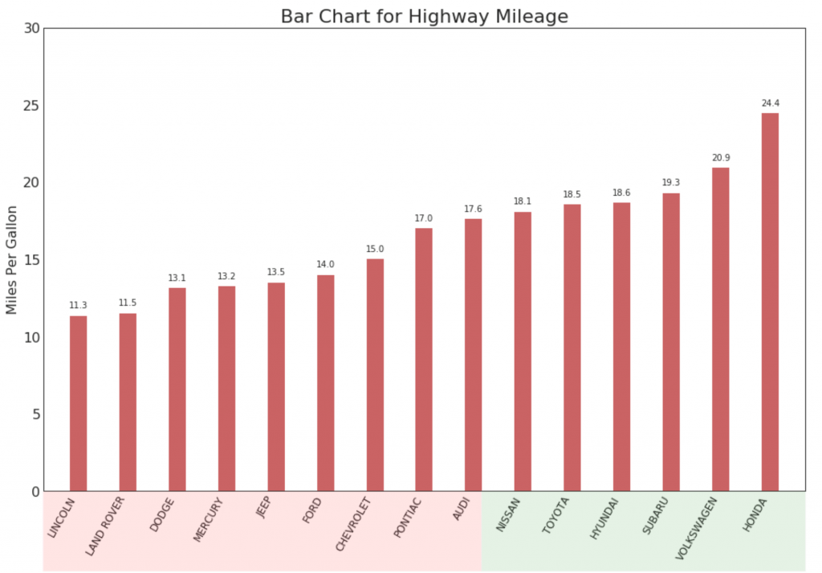
What is Matplotlib?
Graphing package in Python, provides an easy way to visualise data.

Slide 6
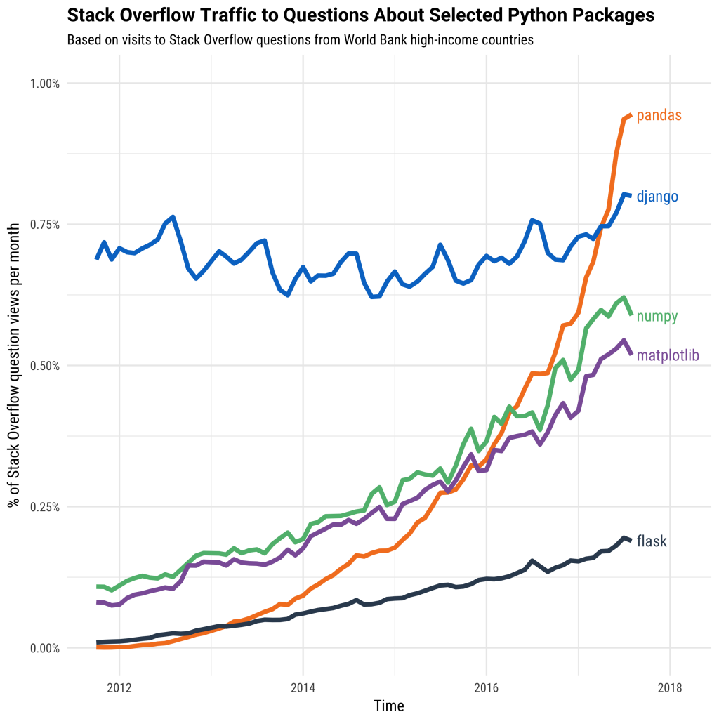

Slide 7
Overview of data cleaning
Raw data is rarely perfectly formatted and ready to use. Some values may be missing and need to be replaced or have the row dropped entirely.
For example consider the following list:
[4, 6, 32, NaN, 55, 2]
This will cause issues for us later down the line when we create our models

Slide 8
Cleaning continued
Having values as ‘NaN’ can throw off machine learning models and produce erroneous results.
Another example of cleaning is selecting only the columns of data that correspond to the analysis you would like to perform.
Name | Age | Dog’s Name
Ben | 44 | Tilly
Jacob | 34 | Jeremy
Nick | 88 | Foxy

Slide 9
Download the project file from:
https://datasciencesociety.city
Upload it to:
https://jupyter.org/try

Slide 10
Next Week:
Machine learning algorithms & what makes a good model

